Slide 1





Customer Sentiment
and trend analysis
Algorithmic Mavericks Team

Slide 2



Our Team
Hadeel Wael Salah
Amr Essam Gouda
Youssef Wael AL-Sharqawi
A’laa Ahmed Abdel Hay
Aya Attia Abdel Hamid
Ebtehal Karm Shehatah

Slide 3



Agenda
Our Team
Advanced Techniques
Definition
MLOps
Preprocessing
Assistant chat GPT
Data science & Machin learning

Slide 4


Definition
Customer sentiment analysis uncovers the emotions behind customer interactions. Using techniques like natural language processing (NLP) and machine learning, it analyzes feedback from reviews, social media, and surveys. This helps businesses address issues, improve products, and build customer loyalty, turning feedback into valuable insights that drive growth and satisfaction.

Slide 5

Week 1
Data Collection and Preprocessing
a.Data collection
b.Data preprocessing
1. Text Cleaning
5.Lemmatization
2. Remove punctuation
6.Vectorization
3. Tokenization
4.Remove Stop-words

Slide 6
Week 2
Data Science and Machine Learning

Slide 7
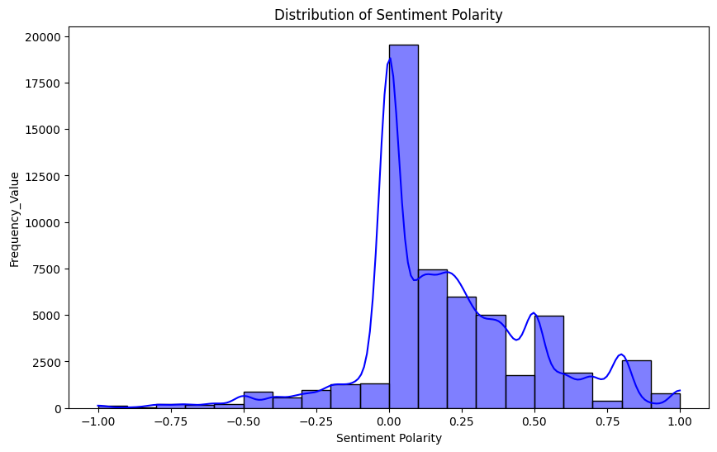
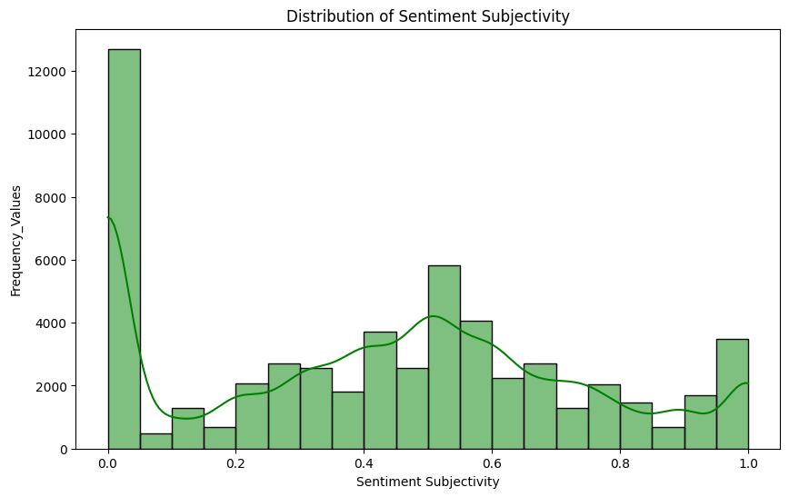
Data Analysis EDA :
Sentiment Analysis:
- Polarity Distribution.
- Subjectivity Distribution.

Slide 8
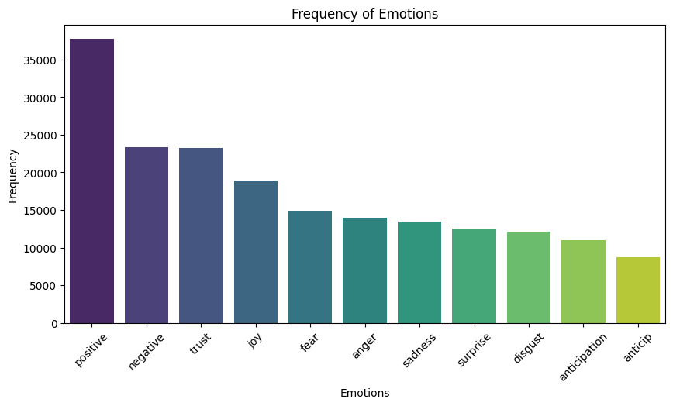
Emotion Analysis :
- Extract the actual emotion.
- Frequent Emotion :
The most frequent emotion is 'positive'.
The least frequent emotion is 'anticip'.

Slide 9
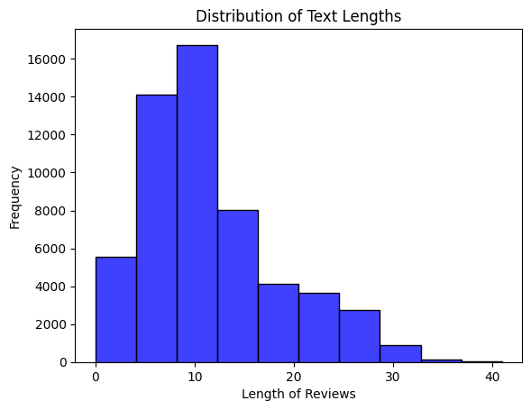
Analyze text with the most frequent length?
the length of the most frequent text (most texts have length 10).

Slide 10
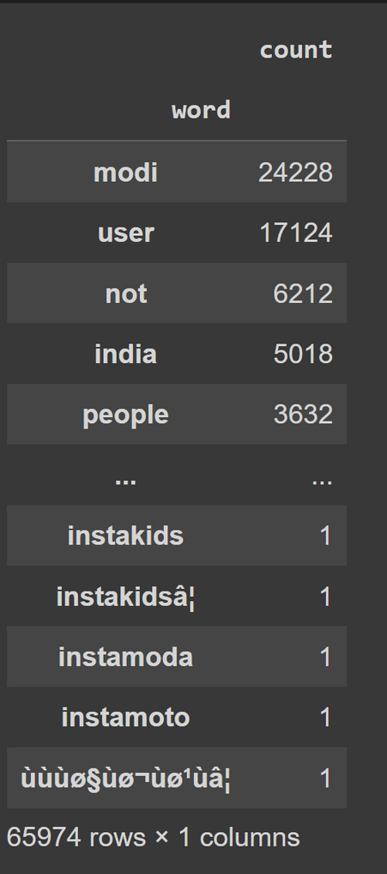
Word Frequency Highlights
the most word repeated in text 'modi'.
thee are more than one word is the least.

Slide 11
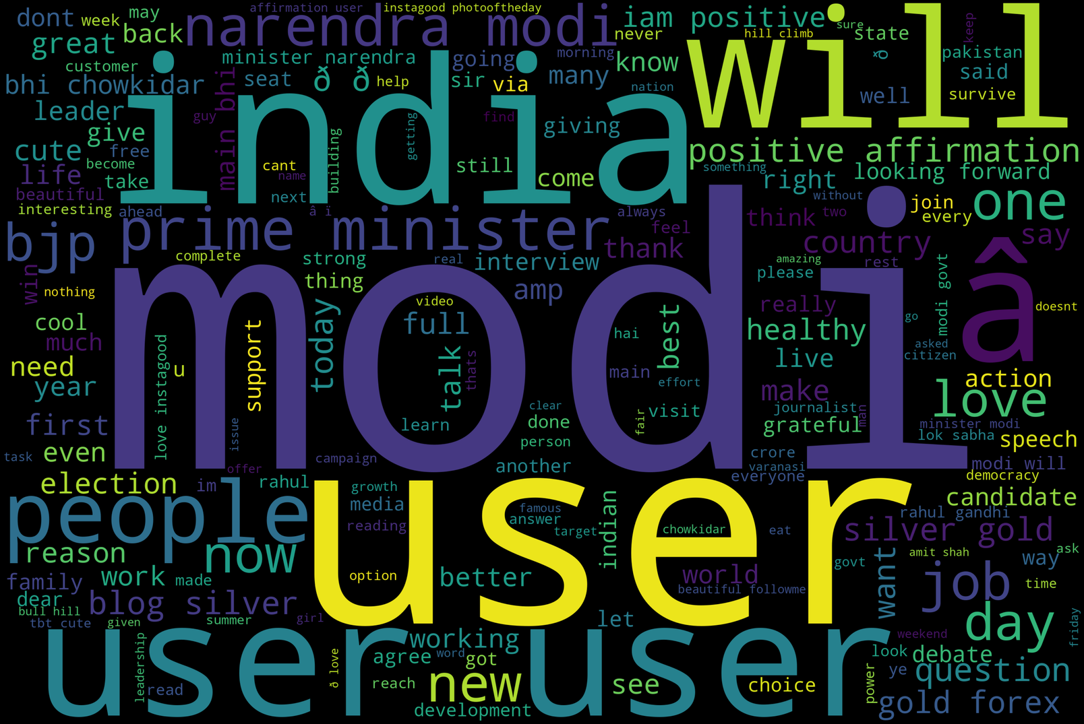
Some visaulization for positive and negative reviews
using Wordcloud
PositiveWords

Slide 12
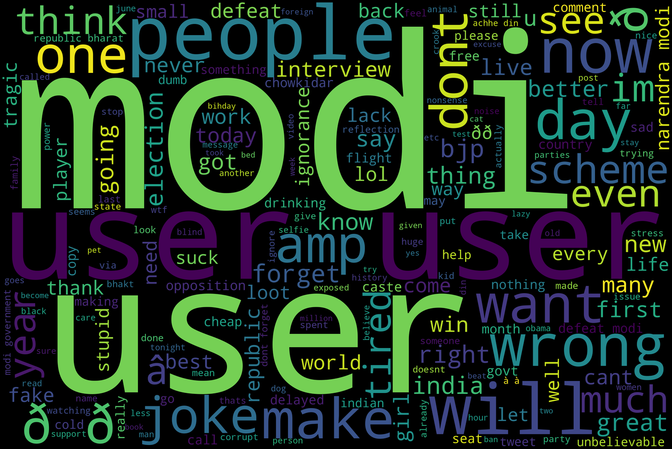
NegativeWord

Slide 13
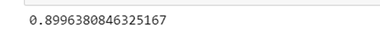
Model :
Train-Test Split
Model Building
Training the Model:
· Model Evaluation:

Slide 14
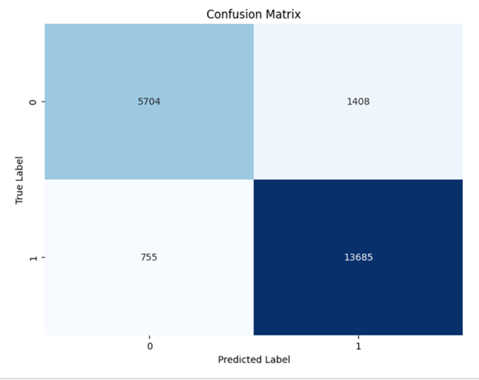
·Confusion Matrix Visualization

Slide 15
week 3
Advanced Technique & Deployment

Slide 16
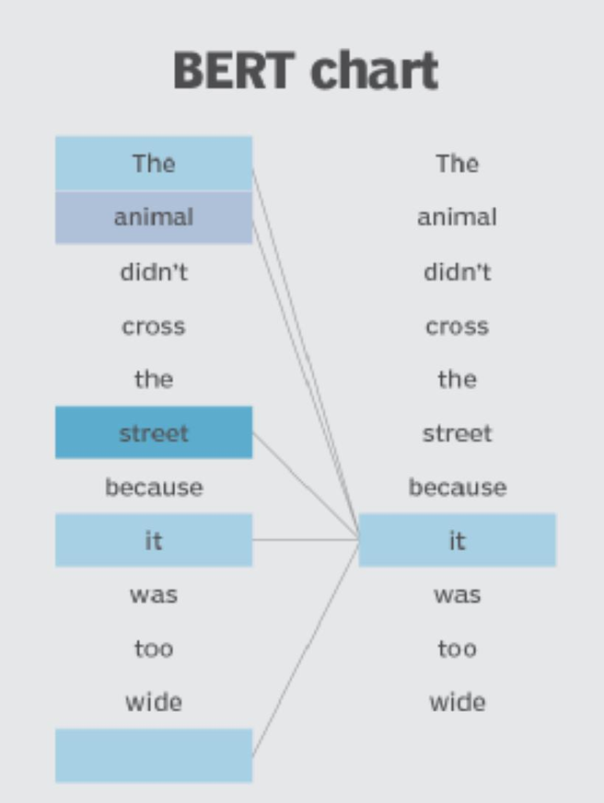
NLP& PERT Model:
NLP preprocessing
What is the PERT model in detail?
PERT process

Slide 17


Flask :
step 1
step 2
input and output
Pipeline

Slide 18
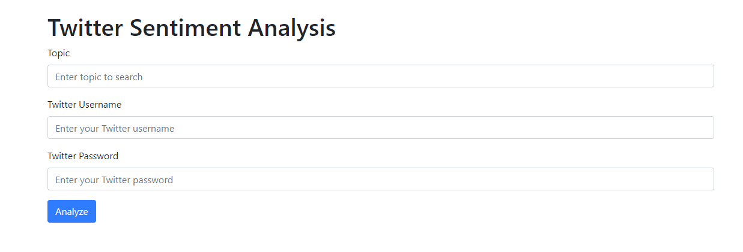
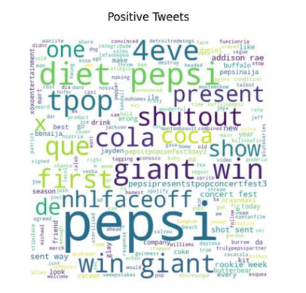
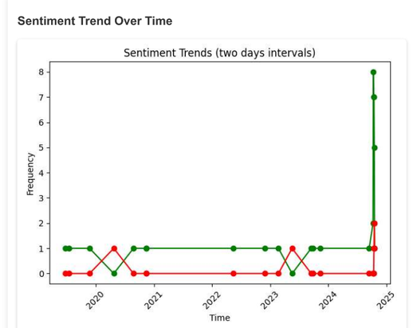
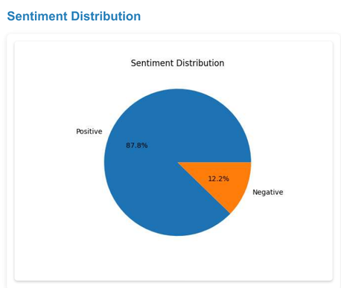
Flask :
step 1
input and output

Slide 19






Flask :
step 2
Pipeline
Web Scraping
Preprocessing
Prediction
Visualization

Slide 20
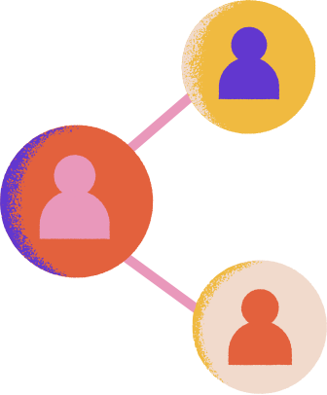
week 4
MLOps & Assistant chat GPT

Slide 21
ML flow :
step 1
step 2
5 models runs
chosen one

Slide 22
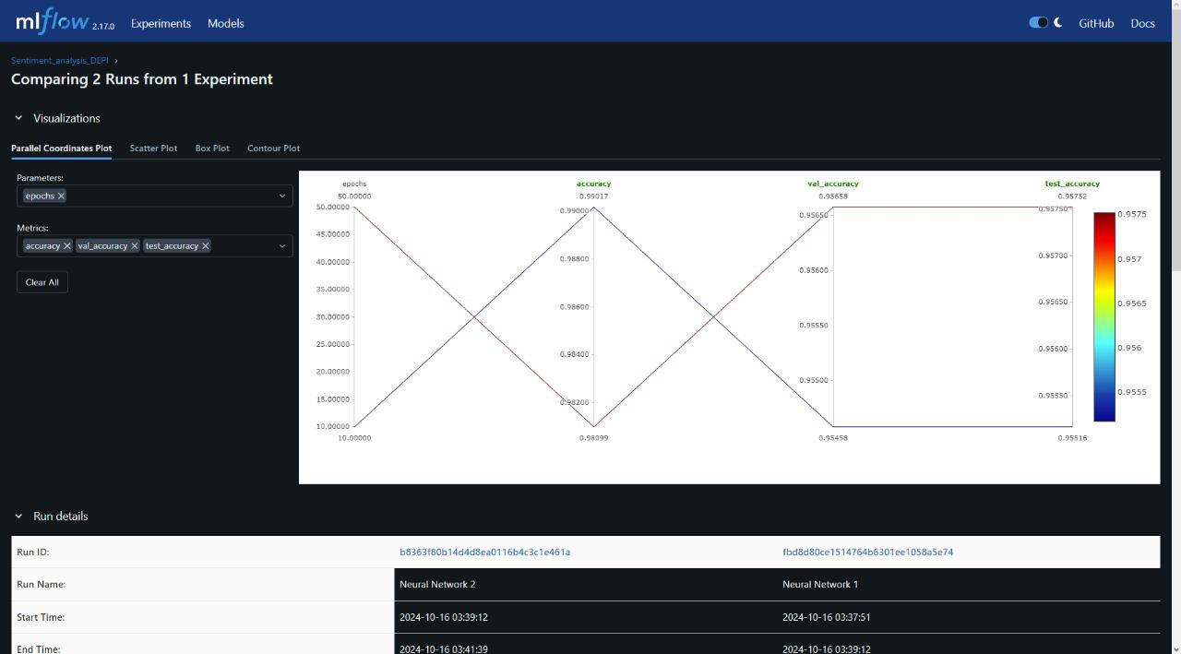

Slide 23

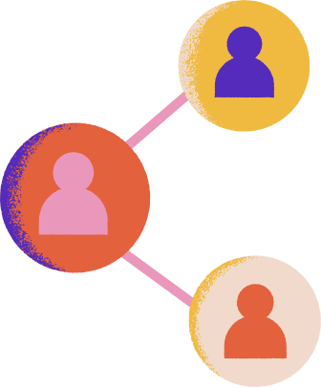


Assistant chat GPT
1- Text Generation for Customer Support Automation :
Goal: Automatically generate professional, brand-consistent responses to negative comments or queries.
2-Generate solutions from ChatGPT to improve service.
Goal: Improving service and providing more effective and creative solutions.

Slide 24
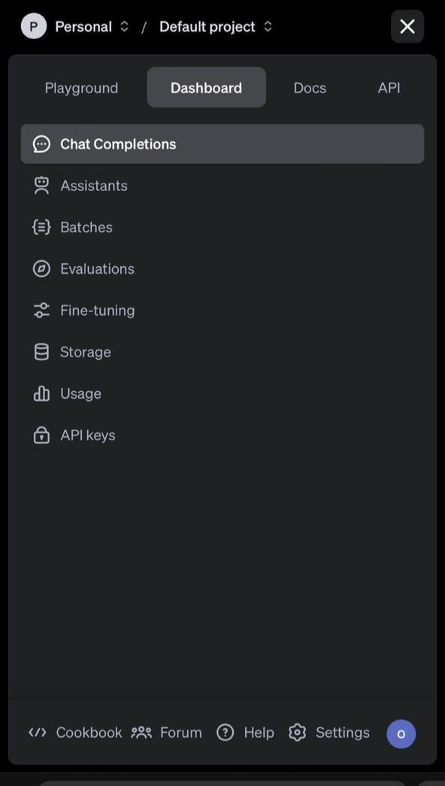
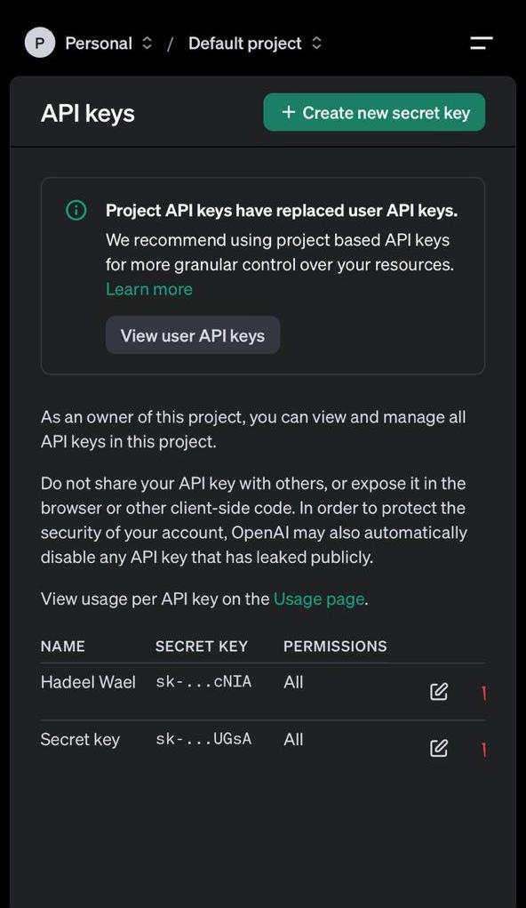
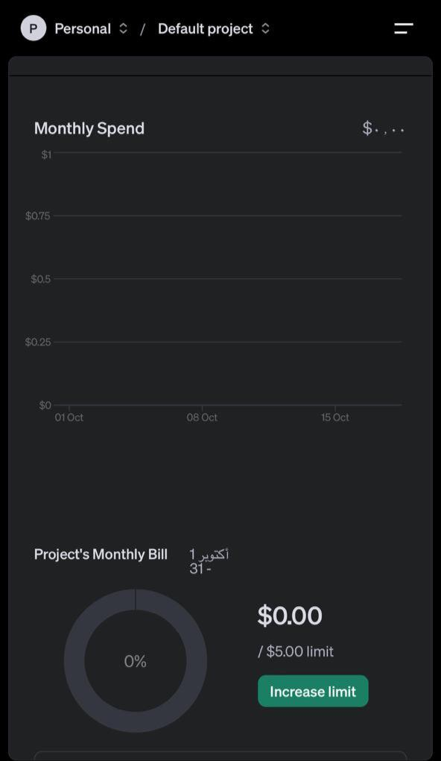

Slide 25


Thank you for listening

